Slide 1
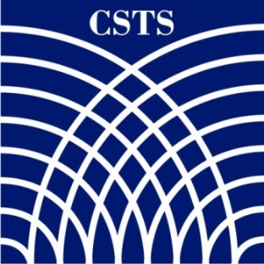

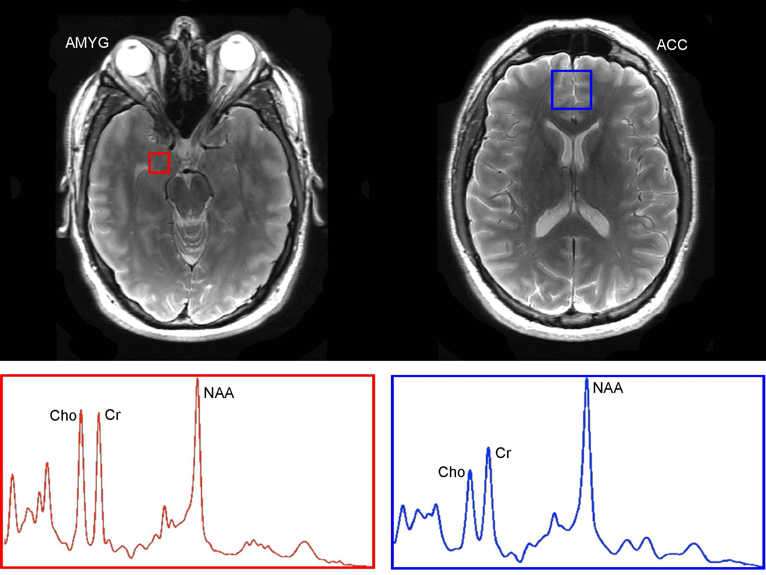

Riluzole for PTSD: Efficacy of a Glutamatergic Modulator as Augmentation Treatment for Posttraumatic Stress Disorder
Patricia T. Spangler^{1,2}, James C. West^{1,2}, Brian Andrews-Shigaki², Kyle Possemato³, Shannon McKenzie³, Maegan Paxton¹,
Tung Tu¹, Krista Engle¹, and David M. Benedek^{1,2}
¹Center for the Study of Traumatic Stress; ²Uniformed Services University of the Health Sciences; ³Syracuse VA Medical Center
Introduction
Methods (cont.)
Table 2. Pre- to Post-Treatment Psychometric and Neuroimaging Results for WRNMMC.
Current pharmacological treatment for PTSD, particularly combat-related PTSD^{1,2}, is suboptimal, leaving an urgent need to develop novel treatments that rapidly and robustly improve symptoms. Increased concentrations of glutamate in the brain have been linked to cognitive effects that are correlated with PTSD symptoms³. Drugs that alter neuronal survival pathways through reduction of glutamate activity may play a role in reversing the loss of neuronal integrity and possible focal atrophy in regions of the brain implicated in the pathophysiology of PTSD (e.g., amygdala and anterior cingulate cortex), potentially improving the symptoms of PTSD, as well as mild traumatic brain injury (mTBI). Riluzole is a glutamatergic modulator that is FDA approved for treating amyotrophic lateral sclerosis (ALS) and has been found to have antidepressant⁴ and anxiolytic properties⁵. It may enhance the effect of PTSD medications and help reduce traumatic stress symptoms. The current study is a randomized controlled trial evaluating the efficacy of acute riluzole treatment for combat-related PTSD in service members and veterans, with or without mTBI, who have responded suboptimally to other pharmacologic treatments.
Outcome variables include PTSD, depression, anxiety, and global functioning, which are assessed at pre-, mid-, and post-treatment. In addition, a subgroup of eligible participants from WRNMMC is undergoing magnetic resonance spectroscopy pre- and post-treatment to evaluate changes in N-acetyl aspartate (NAA) absolute concentration levels in the amygdala (AMYG) and anterior cingulate cortex (ACC).
Proton magnetic resonance spectroscopy (¹H MRS) is an in vivo technique that provides direct neurochemical information about regions of interest in the brain (Fig. 1). NAA levels serve as a surrogate marker for neuronal integrity and reflect extent of neuronal loss or injury^{7,8}. Reduced NAA/CR ratios in the ACC and hippocampus have been reported in combat veterans⁹ and PTSD patients¹⁰. The current study will evaluate pre- to post-treatment changes in absolute NAA concentrations and well as changes to NAA/Cr ratios in the ACC and amygdala.
Hypotheses: (1) Participants randomized to riluzole will have superior improvement in PTSD symptoms compared to subjects given placebo. (2) Participants randomized to riluzole will have significant improvement in depression, anxiety, and global functioning compared to those given placebo. (3) NAA concentrations in the amygdala and anterior cingulate, measured using ¹H MRS, will increase after 8-week treatment with riluzole.
Variable | Control (n) | Treatment (n) | Mean Diff. | t-test | One-sided p-value | Effect Size (Cohen’s d)
CAPS | -19.00 (6) | -21.00 (9) | 2.00 | 0.33 | 0.373 | 0.174
MADRS | -3.83 (6) | -8.89 (9) | 5.06 | 1.40 | 0.092 | 0.738
HAM-A | -8.27 (6) | -5.52 (9) | 2.75 | 0.05 | 0.482 | 0.025
NAA-Amyg | -1.44 (4) | 0.65 (5) | 2.09 | -2.39 | 0.024 | 1.604
NAA/Cr Ratio-Amyg | -0.01 (4) | 0.13 (5) | 0.14 | -0.93 | 0.193 | 0.621
NAA-ACC | -0.47 (5) | 0.30 (5) | 0.78 | -1.73 | 0.061 | 1.091
NAA/Cr Ratio-ACC | -0.07 (5) | 0.01 (5) | -0.09 | -0.66 | 0.264 | 0.417
Methods
Discussion
Up to 100 OIF/OEF/OND veterans aged 18 to 65 are being recruited at Walter Reed National Military Medical Center (WRNMMC) and Syracuse VA Medical Center (SVAMC) for a randomized, double-blind, placebo-controlled, parallel trial. Participants must be currently taking an SSRI or SNRI for PTSD and have a current CAPS score ≥ 40. The study is being conducted in two phases: eligibility screening with a 2- to 4- week stabilization period and an 8-week acute treatment phase.
During the acute phase participants are randomized (1:1) to 8-week treatment with riluzole or placebo. Participants are assessed weekly from Visit 1 through Visit 9. Dosage begins at 100mg/day and is increased to 200 mg/day if a participant’s PTSD Checklist score does not decrease by 10 or more points after 2 weeks of treatment.
The current study is the first known RCT of the glutamatergic modulator, riluzole, for combat-related PTSD symptoms following suboptimal response to pharmacologic treatment. Preliminary pre- to post-treatment t-test of psychometric data indicate a trending difference between groups in decrease in depression symptoms. Pre- to post- treatment neuroimaging results indicated significant differences between treatment and control in NAA concentrations in amygdala and anterior cingulate cortex, with participants receiving riluzole showing greater improvements. We had unequal sample sizes of neuroimaging and psychometric data due to poor signal-to-noise ratio and early cases being used for imaging calibration. Given the very small sample size for these analyses, results should be viewed with caution and should not as yet be taken as evidence of riluzole’s efficacy. The results do show, however, that we are able to successfully collect psychometric and neuroimaging data for this medication trial. By investigating symptom change and neurochemical changes in brain regions implicated in PTSD symptomatology, the current study will help determine the therapeutic benefit of riluzole while further elucidating its neuroprotective effects in regions of interest.
References and Acknowledgements
DoD-VA Practice Guideline for the Management of Posttraumatic Stress, 2010.
van der Kolk BA, Dreyfuss D, Michaels M, Shera D, Berkowitz R, Fisler R, Saxe G. Fluoxetine in posttraumatic stress disorder. J Clin Psychiatry 1994; 55:517-522.
Sherin JE, & Nemeroff CB. Post-traumatic stress disorder: the neurobiological impact of psychological trauma. Dial Clin Neurosci 2011;13(3):263–278.
Zarate CA, Jr., Payne JL, Quiroz J et al. An open-label trial of riluzole in patients with treatment-resistant major depression. Am J Psychiatry 2004 January;161(1):171-4.
Mathew SJ, Price RB, Mao X, Smith EL, Coplan JD, Charney DS, Shungu DC. Hippocampal N-acetylaspartate concentration and response to riluzole in generalized anxiety disorder. Biol Psychiatry. 2008 May 1;63(9):891-8.
Sager TN, Topp S, Torup L, Hanson LG, Egestad B, Moller A. Evaluation of CA1 damage using single-voxel 1H-MRS and un-biased stereology: Can non-invasive measures of N-acetyl-asparate following global ischemia be used as a reliable measure of neuronal damage? Brain Res 2001 February 16;892(1):166-75.
Ebisu T, Rooney WD, Graham SH, Weiner MW, Maudsley AA. N-acetylaspartate as an in vivo marker of neuronal viability in kainate-induced status epilepticus: ¹H magnetic resonance spectroscopic imaging. J Cereb Blood Flow Metab 1994 May;14(3):373-82.
Villarreal G, Petropoulos H, Hamilton DA et al. Proton magnetic resonance spectroscopy of the hippocampus and occipital white matter in PTSD: preliminary results. Can J Psychiatry 2002 September;47(7):666-70.
Mahmutyazicioglu K, Konuk N, Ozdemir H, Atasoy N, Atik L, Gundogdu S. Evaluation of the hippocampus and the anterior cingulate gyrus by proton MR spectroscopy in patients with post-traumatic stress disorder. Diagn Interv Radiol 2005 September;11(3):125-9.
Friedman MJ, Marmar CR, Baker DG, Sikes CR, Farfel GM. Randomized, double-blind comparison of sertraline and placebo for posttraumatic stress disorder in a Department of Veterans Affairs setting. J Clin Psychiatry 2007 May;68(5):711-20.
Zohar J, Amital D, Miodownik C et al. Double-blind placebo-controlled pilot study of sertraline in military veterans with posttraumatic stress disorder. J Clin Psychopharmacol 2002 April;22(2):190-5.
Acknowledgements: We thank Jing Wang, Center for the Study of Traumatic Stress; Gail Kohls, MR technologist at WRNMMC; and Jason Schroeder, neuroradiologist at USUHS and WRNMMC, for their hard work and dedication to this project.
Fig. 1. Transverse images of voxel location and spectrograph for amygdala (left) and anterior cingulate cortex (right). The dominating peaks of NAA, creatine (Cr) and choline (Cho) are labeled. Concentration levels of NAA compared pre- to post-treatment.
Preliminary Findings
A total of 26 participants have completed the trial to date at both sites (WRNMMC n = 15; SVAMC n = 11), with a mean age of 35.92 years (SD = 8.59). The sample is 84.6% male, 80.8% White, 53.8% married, and 84.6% with a current/highest rank of E4-E9. WRNMMC data were used in preliminary pre- to post-treatment analyses because neuroimaging was conducted at WRNMMC only. Preliminary t-test results indicate a significant difference between groups in change in NAA concentration in amygdala and near significant difference in ACC, such that participants randomized to riluzole had increases in NAA in both regions, whereas participants randomized to placebo had NAA concentration decreases in both regions (Figs. 1a and 1b). On psychometric measures, there was a trend toward significant difference in depression change scores (MADRS), with a moderate effect size (d = .74), such that participants randomized to riluzole had greater decreases in depression than did those randomized to placebo.
Figs. 1a and 1b. Graphed results of pre- to post-treatment neurochemical changes show significant differences between treatment and control on absolute NAA concentrations (an indicator of neuronal integrity) in amygdala and ACC.
The views expressed in this presentation are those of the author and do not reflect the official policy of the Department of Army/Navy/Air Force, Department of Defense, or U.S. Government.

